Slide 1

Rationale
Introduction to Windows Store App Development Using HTML5 and JavaScript
Computer science is a field of study that deals with solving a variety of problems by using computers.
  To solve a given problem by using computers, you need to design an algorithm for it.
Multiple algorithms can be designed to solve a particular problem.
An algorithm that provides the maximum efficiency should be used for solving the problem.
  The efficiency of an algorithm can be improved by using an appropriate data structure.
Data structures help in creating programs that are simple, reusable, and easy to maintain.
This module will enable a learner to select and implement an appropriate data structure and algorithm to solve a given programming problem.

Slide 2
Objectives
  In this session, you will learn to:
  Organize the various UI elements
Notes:
2

Slide 3
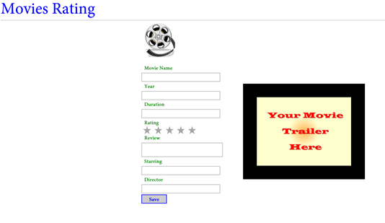
Demo: Creating Layout-aware Apps
  Problem Statement:
  Nancy has created the UI of the Movie Rating app. Now, she wants that the UI of the app should be displayed appropriately in the full view and snapped view of the app. The following figure depicts the UI of the Movie Rating app in full view.
Notes:
3

Slide 4
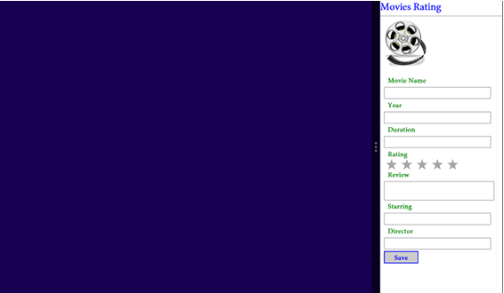
Demo: Creating Layout-aware Apps (Contd.)
  The following figure depicts the UI of the Movie Rating app in snapped view.
  Help Nancy in updating the app to make it layout-aware.
Notes:
4

Slide 5
Demo: Creating Layout-aware Apps (Contd.)
  Solution:
  To create the desired layout of the preceding app, Nancy needs to perform the following tasks:
    1. Update the interface.
    2. Define styles for different views.
    3. Execute the app and verify the output.
Notes:
5

Slide 6
Summary
  In this session, you learned that:
  You need to add styles under the media queries to create layout-aware apps.
Notes:
6

Slide 7

Q&A

